Slide 1

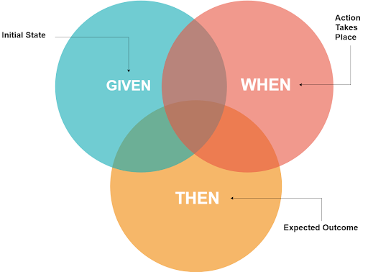
Behaviour Driven Development Framework Using Cucumber

Slide 2
Agenda
Tools Used
Automation Framework Architecture
Sample Report

Slide 3
Tools And Their Significance
Cucumber- Cucumber can be defined as a testing framework, driven by plain English text. It serves as documentation, automated tests, and a development aid – all in one.
Selenium –Key features like Language and Framework Support, Open Source Availability, Multi-Browser Support, Support Across Various Operating Systems, Ease Of Implementation, Reusability and Integrations makes Selenium better choice for Test Automation.
Core Java - There is an abundance of readily available frameworks, plugins, APIs and libraries that supports Java for test automation.

Slide 4
Tools And Their Significance
Maven(Build Tool) - Maven is a powerful project/ build management tool, which is based on the concept of a POM (Project Object Model) contains project information and configuration information for the maven to build the project like build directory, source directory, dependencies, test source directory, goals, plugin, etc.
Version control - System(Git/Bitbucket) & CI/CD(TeamCity)

Slide 5
Framework Architecture
Feature(s)
Given
When
Then
Test Cases
Selenium Java
Test Runner
To Run Your Feature
To Generate Output/Report
Feature File
Step Definition
Test Runner

Slide 6
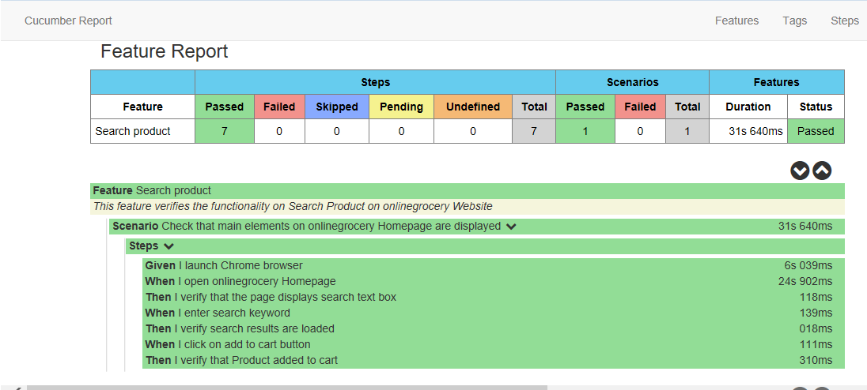
Reporting
BDD Framework Reporting

Slide 7
